Slide 1
Week 3

Slide 2
Describe how some important unsupervised learning models learn and are deployed (k means, pca, association rules, subset evaluation, recommender system’s filtering )
Understand aspects of feature extraction and dimensionality reduction to improve model's performance
Analyse and discuss model selection in unsupervised learning
Design prototypes for clustering, dimensionality reduction, and recommender systems, problems using low code/no code tools.

Slide 3
Some models
k means
PCA, subset selection
Association rules
Evaluation of these models
Recommendation systems

Slide 4
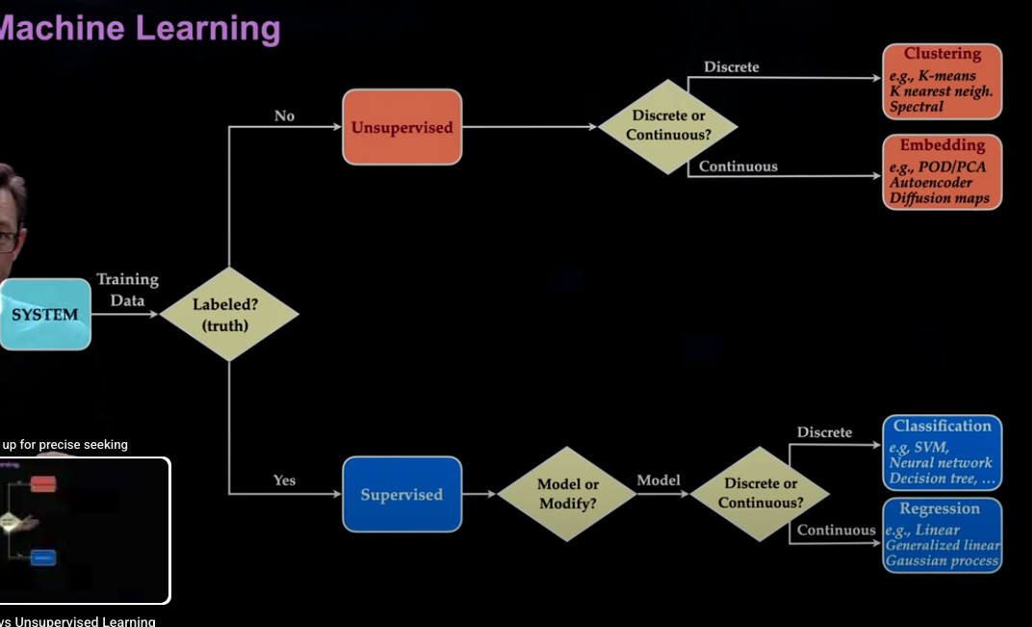











Slide 5
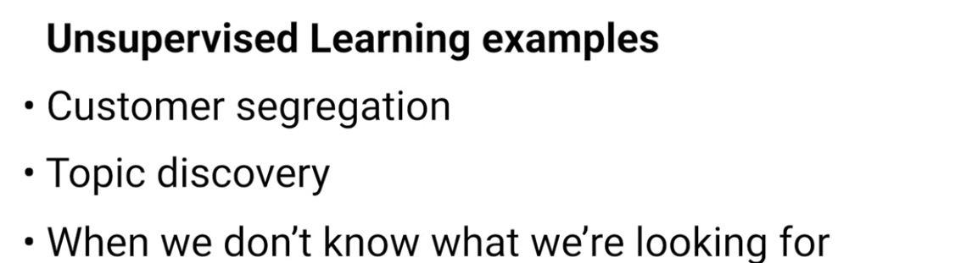
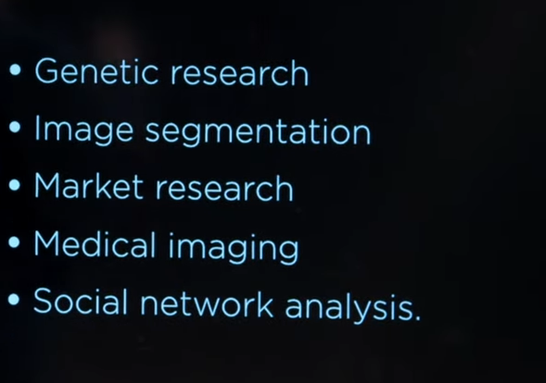















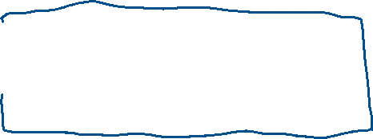








Recommender systems

Slide 6
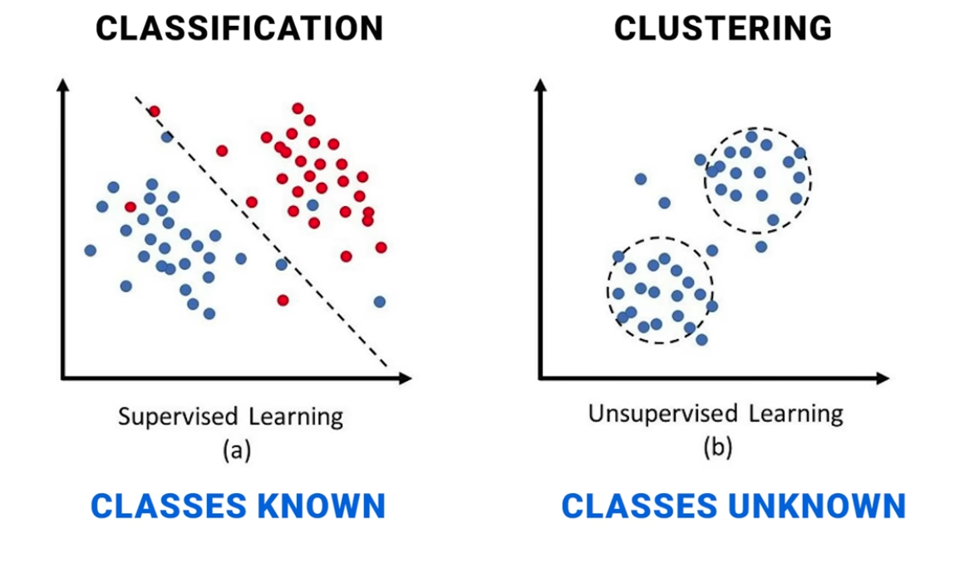
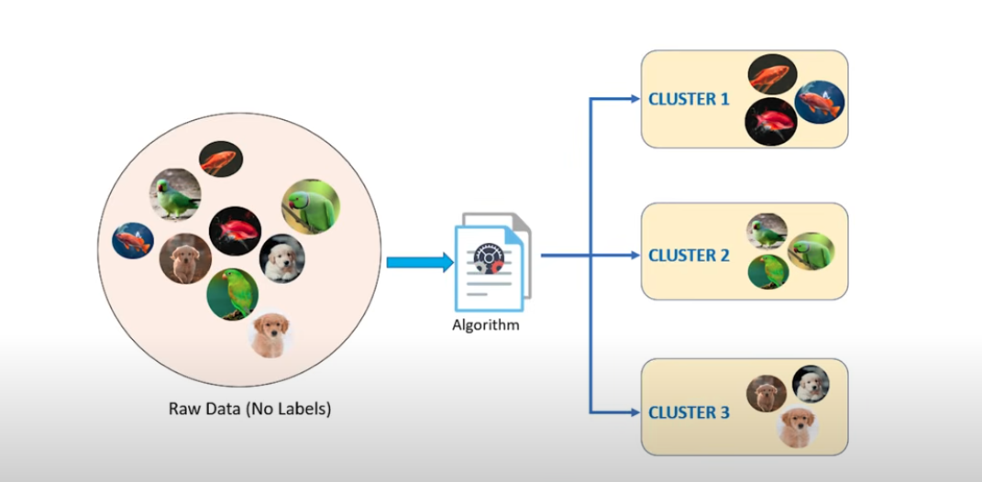
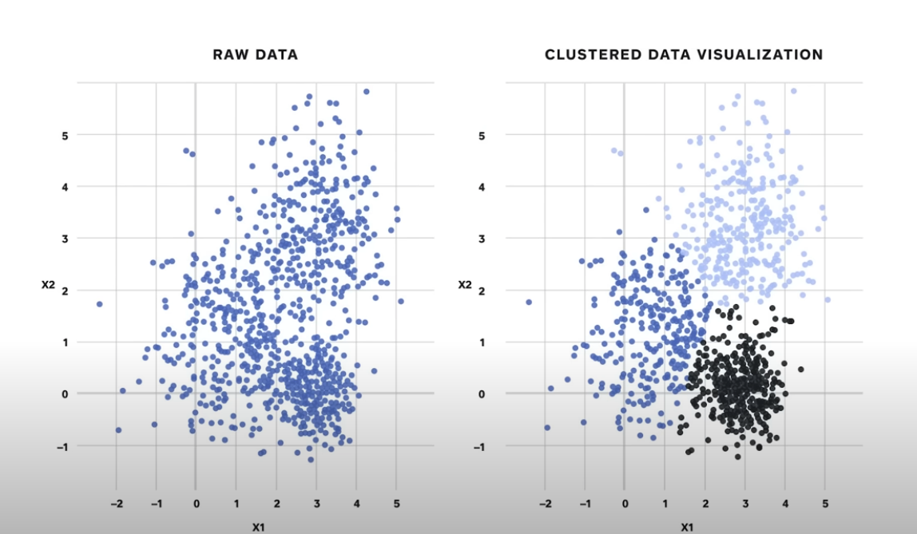



Slide 7
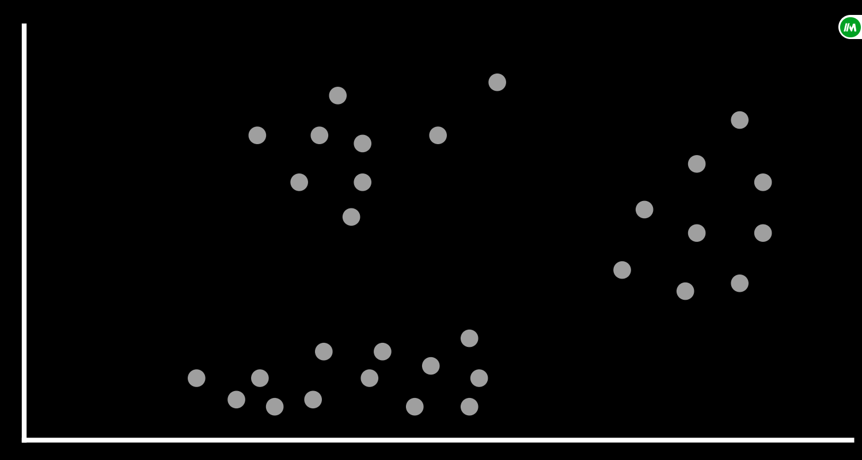
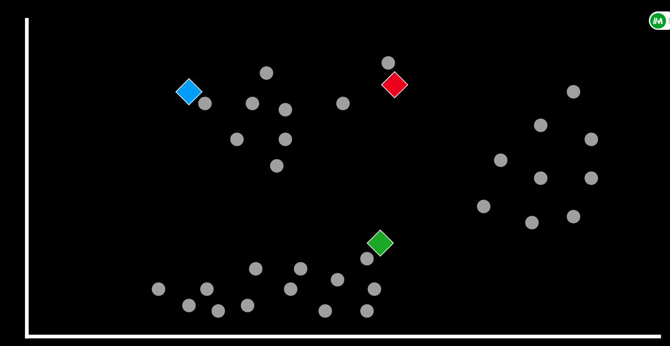
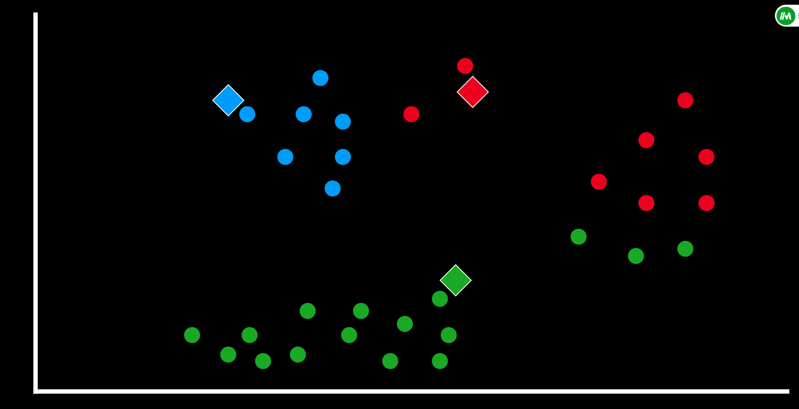
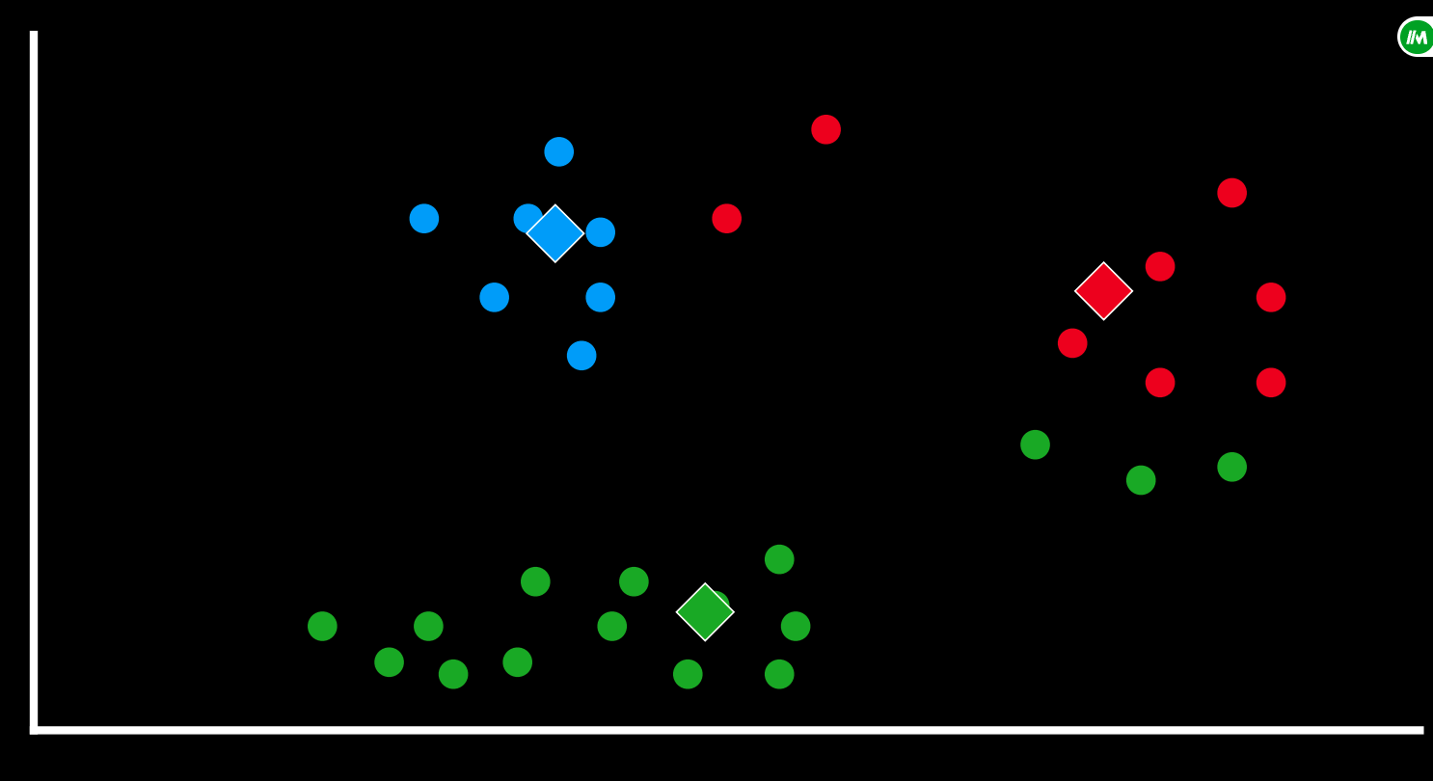
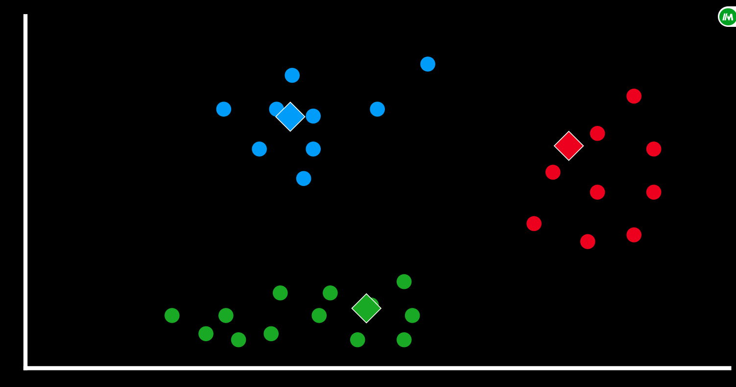
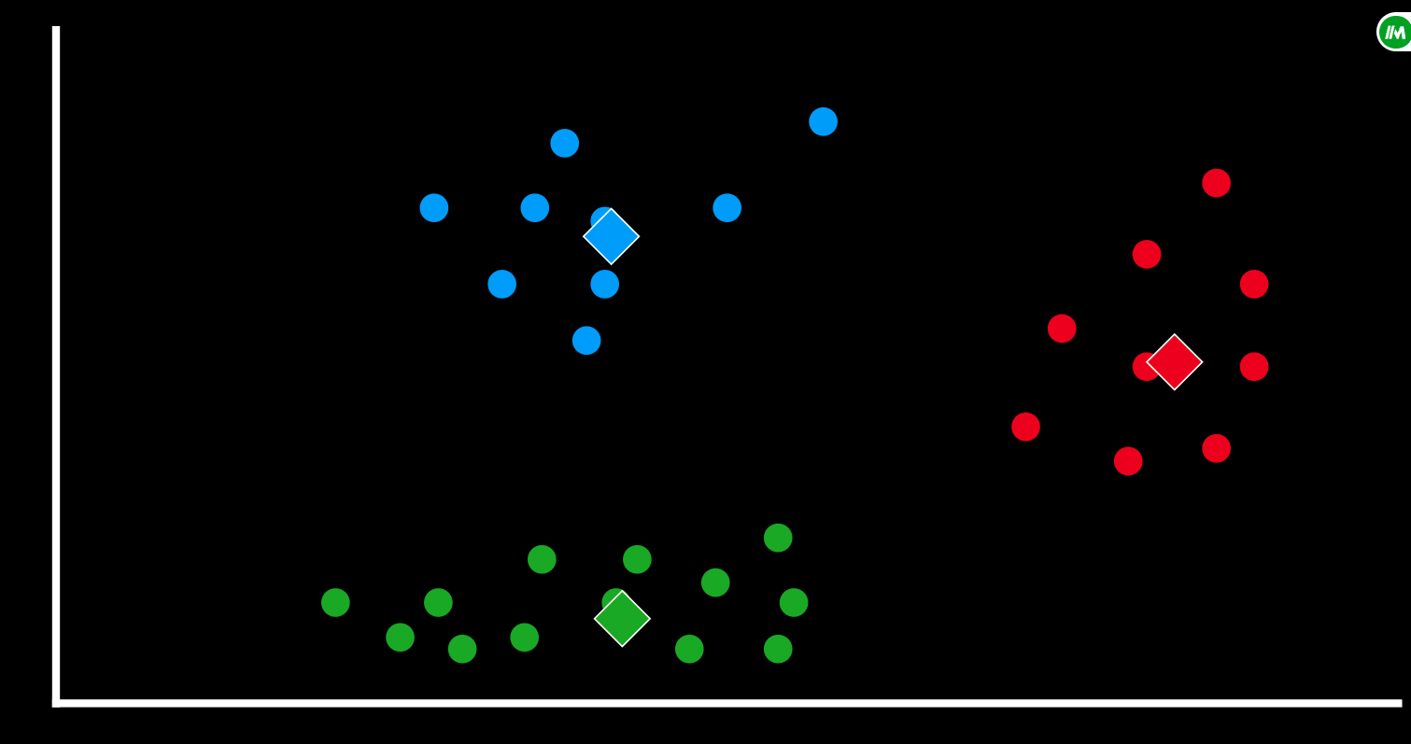






Kmeans

Slide 8
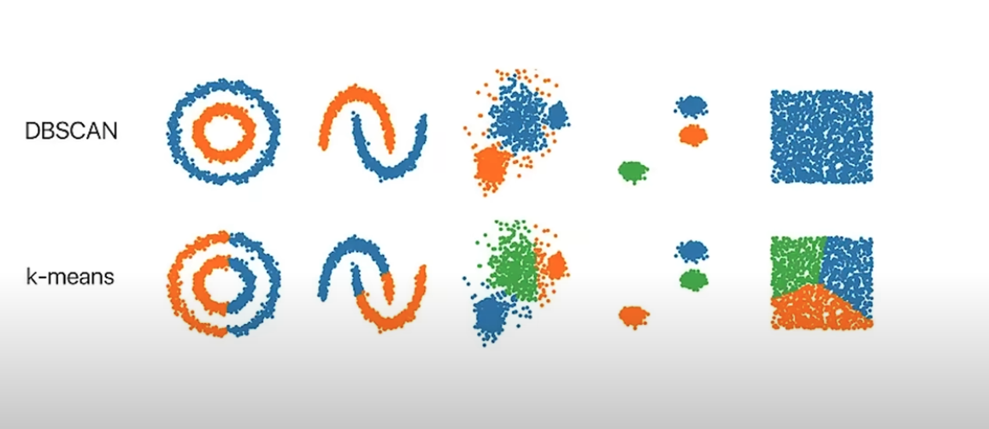

















GMMs

Slide 9
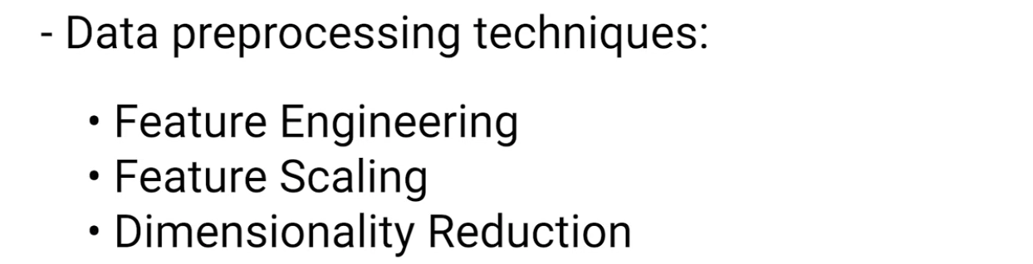
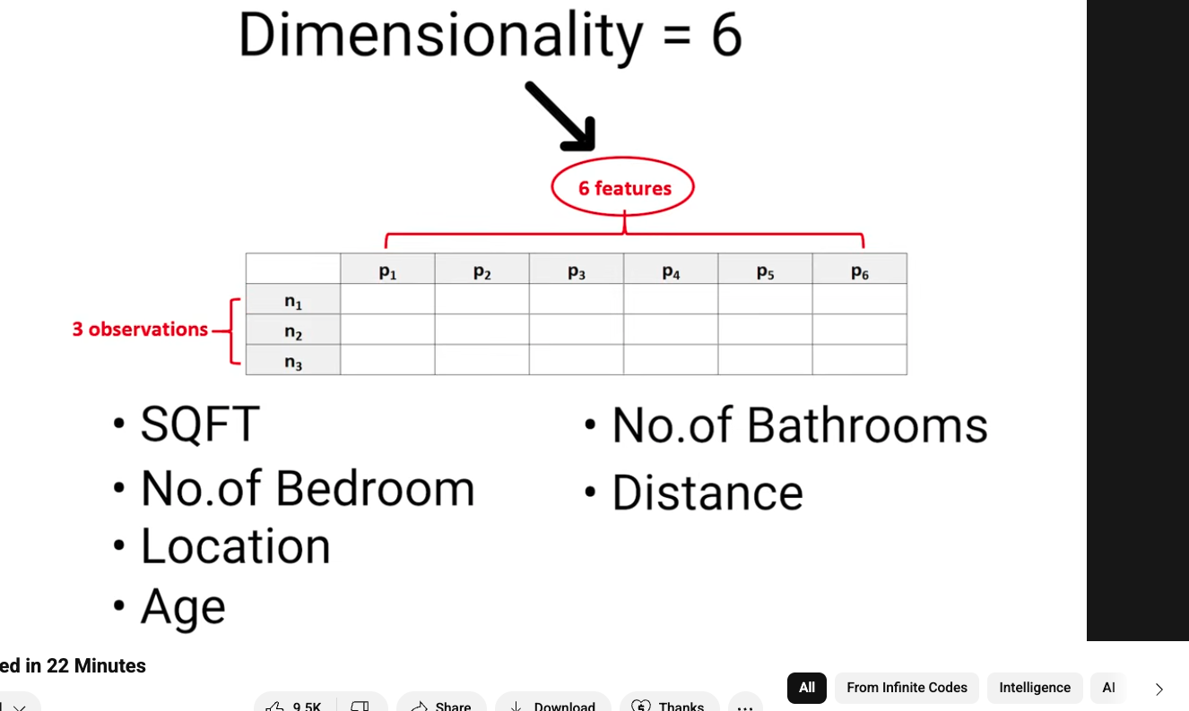






















Slide 10
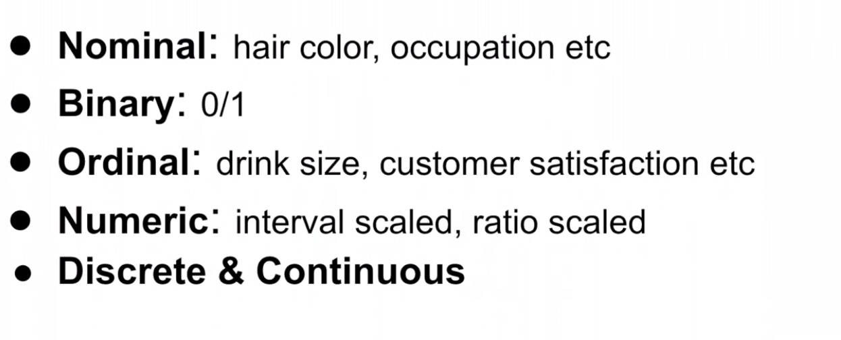














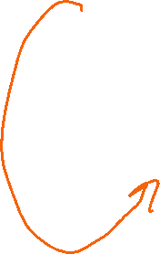



Preprocessing data types, missing values and normalization

Slide 11
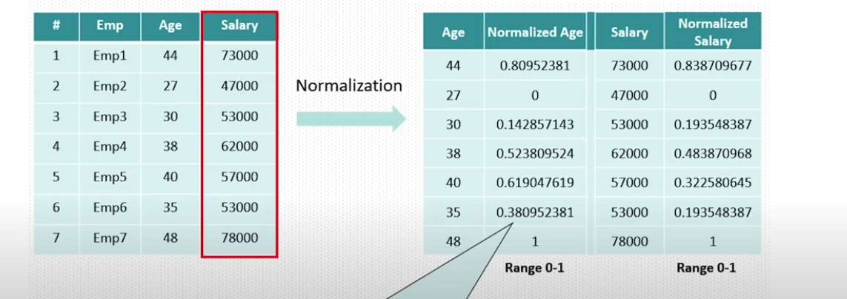





































Preprocessing data types, missing values and scaling
Notes:
focus on the most relevant patterns in
the data feature scaling also called
normalization or standardization is the
process of transforming numeric features
to a similar scale typically to prevent
features with larger ranges from
dominating the learning process for
example here the numbers for salary are
much larger than those for age and
dominate the model fitting common
scaling methods include minmax
normalization thus scaling to a 0 to one
range as seen here or standardization
transforming to mean zero and standard
deviation one proper scaling is
particularly important for many
algorithms like gradient descent and
neural networks which can perform poorly
or converge slowly when features are on
vastly different scales

Slide 12
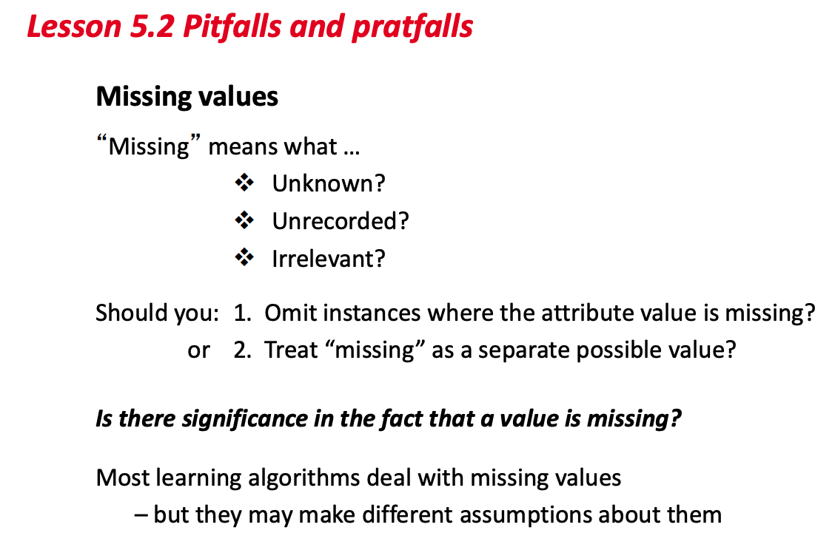




















Preprocessing data types, missing values and normalization
https://www.youtube.com/watch?v=cMcTwSAf9z0
https://www.youtube.com/watch?v=EJO-SEGxLfg

Slide 13
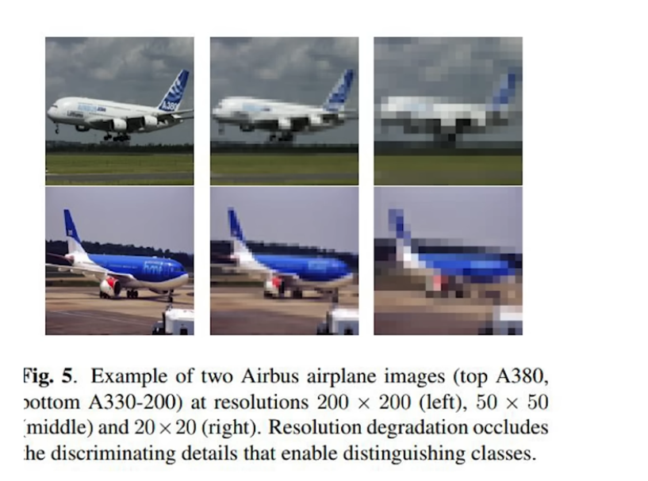
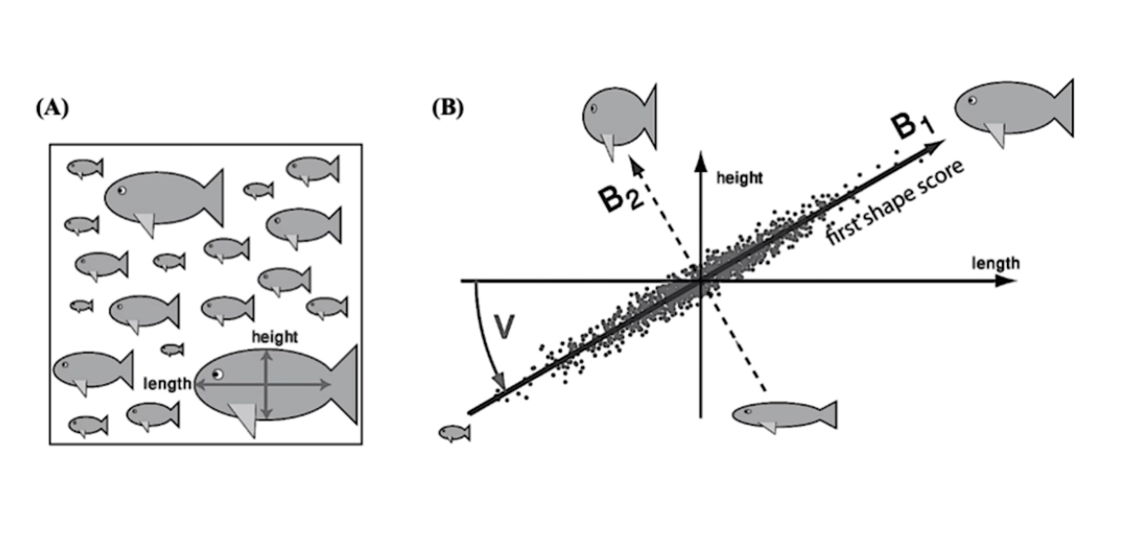


















Dimensionality reduction and
PCA – feature engineering and extraction
https://www.youtube.com/watch?v=9Tf-_mJhOkU
https://www.youtube.com/watch?v=DyxQUHz4jWg
Notes:
principal component analysis or PCA
Principal Component Analysis (PCA)
let's say we are trying to predict types
of fish based on several features like
length height color and number of teeth
when looking at the correlations of the
different features we might find that
height and length are strongly
correlated and including both both won't
help the algorithm much and might in
fact hurt it by introducing noise we can
simply include a shape feature that is a
combination of the two this is actually
extremely common in large data sets and
allows us to reduce the number of
features dramatically and still get good
results PCA does this by finding the
directions in which most variance in the
data set is retained in this example the
direction of most variant is a diagonal
this is called the first principal
component or PC and can become our new
shape feature the second principal
component is orthogonal to the first and
only explains a small fr C of the
variant of the data set and can thus be
excluded from our data set in this case
in large data sets we can do this for
all features and rank them by explain
variants and exclude any principal
components that don't contribute much to
the variant and thus wouldn't help much
in our ml model

Slide 14
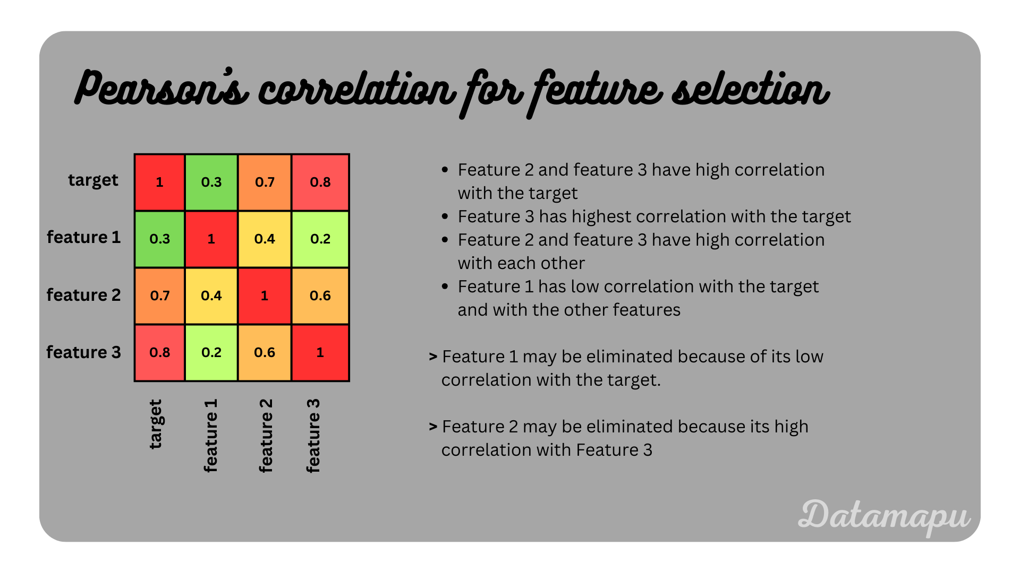
































Slide 15
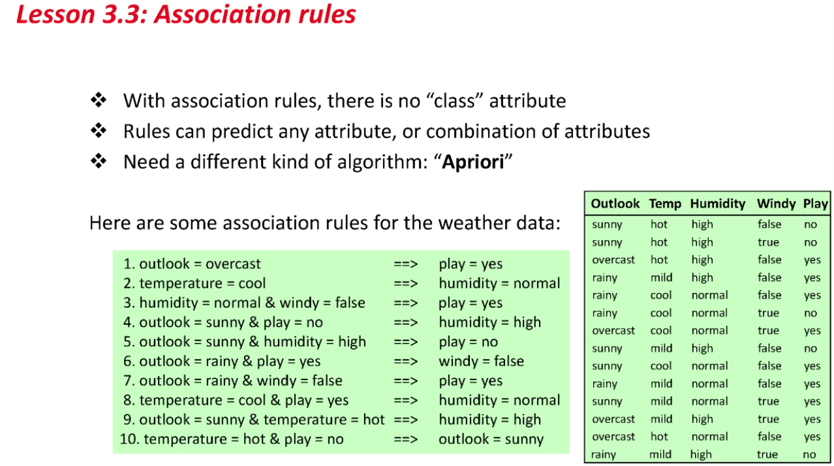
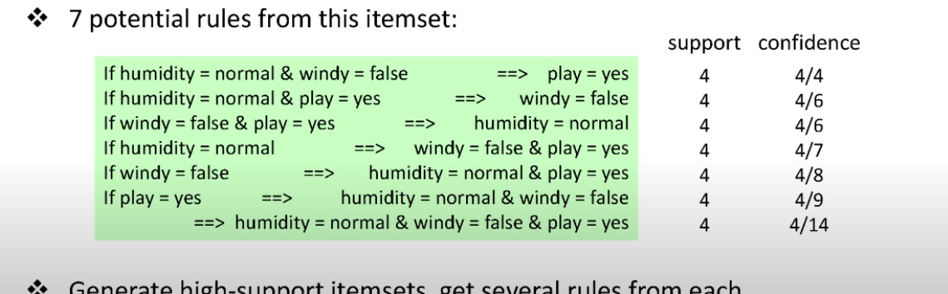
Notes:
I don't know if you remember the weather data from Data Mining with Weka.
Here's this little dataset with 14 instances and a few attributes.
Well, here are some association rules.
"If = outlook=overcast, then play=yes." If you look at that, there are 4 "overcast" instances,
and it's "yes" for all of them: that rule is 100% correct.
"If temperature=cool, then humidity=normal"; that's also 100% correct.
"If outlook=sunny and play=no, then humidity=high." We don't have to predict "play" or indeed
any particular attribute.
If you look at rule #4, "outlook=sunny and play=no," the first 2 instances satisfy that
rule, and there are no other instances that satisfy that rule.
So it's 100% correct, but it only covers 2 instances.
There are lots of 100% correct rules for the weather data.
I think there are 336 rules that are 100% correct.
Somehow we need to discriminate between these rules.
The way we're going to do this is to look at the "support", the number of instances
that satisfy a rule.
The "confidence" is the proportion of instances for which the conclusion holds, and the "support"
is the number of instances that satisfy a rule.
Here I've got the same rules.
They all have 100% confidence, but they've got different degrees of support, different
numbers of instances.
We're looking for high support/high confidence rules, but we don't really want to specify
100% confidence and look for all of those rules, because, like I said, there are hundreds
of them and a lot of them have very low support.
Typically what we do is specify a minimum degree of confidence and seek the rules with
the greatest support with that minimum confidence.
I want to introduce you to the idea of an "itemset".
An itemset is a set of attribute-value pairs, like "humidity=normal and windy=false and
play=yes".
An itemset has got a certain support given a dataset.
Here there are 4 instances in the dataset that are in that itemset.
We can take that itemset and permute it in 7 different ways to produce rules, all of
which have a support of 4.
"If humidity=normal and windy=false than play=yes" has a support of 4 and a confidence of 4/4--that's
100%--because all of the instances for which humidity=normal and windy=false have play=yes.
As we go down this list of rules, we get a lower degree of confidence.
The last rule, for example, doesn't have anything on the left-hand side: "anything implies humidity=normal,
windy=false and play=yes" has a support of 4, but there are 14 instances that satisfy
the left-hand side.
All of the instances satisfy the left-hand side, so the confidence is 4/14.
You can see that as you go down this list of rules, the confidence is decreasing from
100% through 4/6 (67%) down to quite a low value, 4/14.
What Apriori does is generate high-support itemsets.
Then, given an itemset, it gets all the rules from it, and just takes those with more than
an minimum specified degree of confidence.

Slide 16
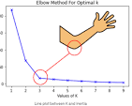


How to evaluate unsupervised learning??
Intracluster Distance:
A good clustering model should have small distances between points within the same cluster (high intracluster homogeneity).
Intercluster Distance:
Points in different clusters should be far apart (high intercluster separation).
Within-Cluster Sum of Squares (WSS): Calculates the sum of squared distances between data points and their cluster centers. Lower WSS values indicate tighter clusters.

Slide 17
https://www.youtube.com/watch?v=Ams4sEn50cw https://www.youtube.com/watch?v=n3RKsY2H-NE

Slide 18
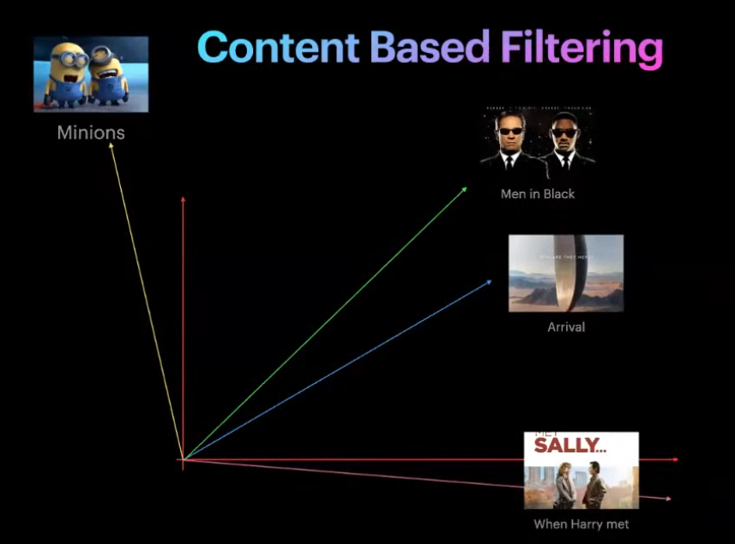








Recommender systems Content based

Slide 19
Recommender systems Content based
Collaborative content

Slide 20
